Slide 1

REVIEW PART V - Bootstrap
Ranken Technical College

Slide 2
Objectives
Install Bootstrap from CDN
Define Mobile Responsive
Explain the Bootstrap grid system
Discuss accessibility with Bootstrap
Discuss Bootstrap theming
Demonstrate Bootstrap utilities

Slide 3
Objectives
Demonstrate Bootstrap navbar
Demonstrate Bootstrap cards
Demonstrate Bootstrap forms & validation
Demonstrate Bootstrap buttons
Demonstrate Bootstrap modals

Slide 4
Using Bootstrap via a CDN
Remember that using a CDN means that you do not have to physically download Bootstrap on your system
However, you must have Internet access to use Bootstrap from a CDN

Slide 5
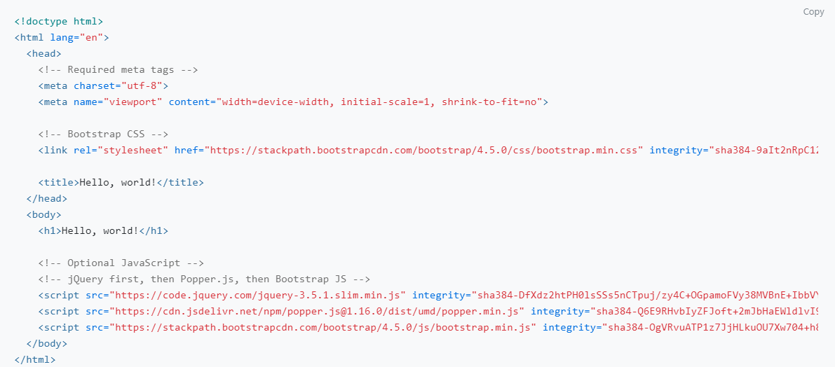
Using Bootstrap via a CDN

Slide 6
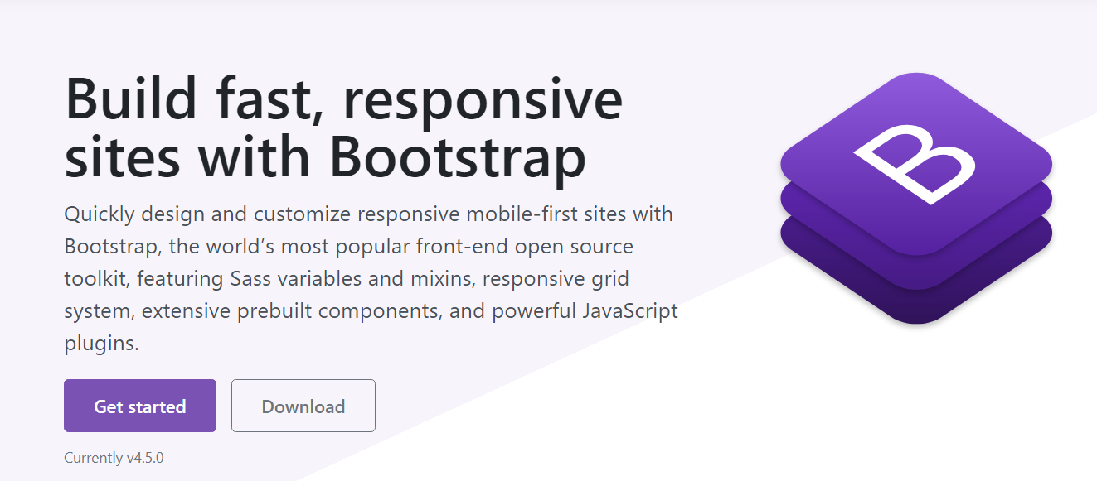
Bootstrap Website
The Bootstrap website, located at URL: https://getbootstrap.com/ is simple but functional:

Slide 7
Mobile Responsive
When a website is responsive , the layout and/or content responds or adapts based on the size of screen they are presented on. A responsive website automatically changes to fit the device it is being read on

Slide 8
The Bootstrap Grid System
The Bootstrap Grid System is a mobile-first fluid grid system made up of a series rows and (typically 12) columns to provide structure to a website
The grid system is built with flexbox and is fully responsive
Source
https://developer.mozilla.org/en-US/docs/Web/CSS/CSS_Flexible_Box_Layout/Basic_Concepts_of_Flexbox

Slide 9
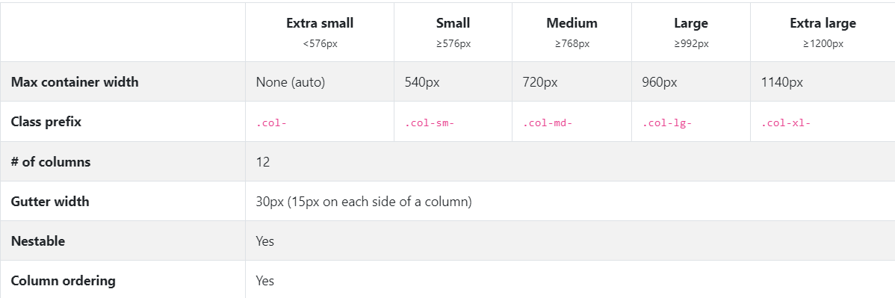
The Bootstrap Grid System

Slide 10
Accessibility Using Bootstrap
A project built with Bootstrap depends in large part on the author's markup, styling, and scripting included
That said, it should be perfectly possible to create websites and applications with Bootstrap that fulfill WCAG 2.0 (A/AA/AAA), Section 508 and similar accessibility standards and requirements
Source
https://www.deque.com/section-508-compliance/

Slide 11
Theming With Bootstrap
Theming in Bootstrap 4 is accomplished by Sass variables, Sass maps, and custom CSS. There’s no more dedicated theme stylesheet. Rather, you enable the built-in theme to add gradients, shadows, etc.
Source
https://bootswatch.com/

Slide 12
Bootstrap Border Utility
The Bootstrap border classes can be used to add or remove borders from an element Color can be added to a border with any of the contextual border color classes. Rounded corners can be added to an element with the rounded classes
Source
https://getbootstrap.com/docs/4.0/utilities/borders/

Slide 13
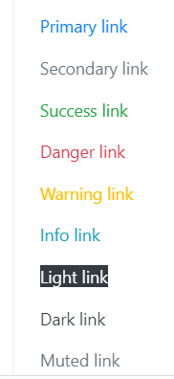
Bootstrap Colors Utility
The Bootstrap color classes can be used on many Bootstrap components, e.g. buttons, divs
Source
https://getbootstrap.com/docs/4.0/utilities/borders/

Slide 14
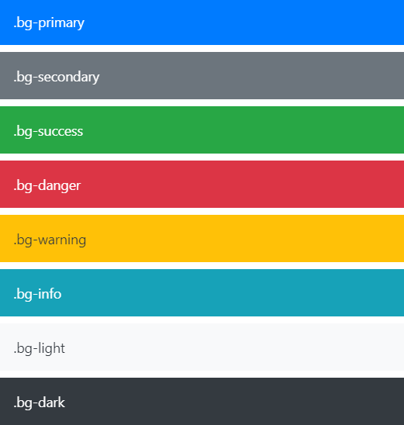
Bootstrap Colors Utility
In addition, the color classes can be used on backgrounds and gradients

Slide 15
Bootstrap Flexbox Utility
The Bootstrap flex classes are used to control the layout of Bootstrap 4 components. Bootstrap 4 uses flexbox instead of floats to handle layout. The Flexible Box Layout Module makes it easier to design flexible responsive layout structure without using float or positioning
Source
https://getbootstrap.com/docs/4.0/utilities/flex/

Slide 16
Bootstrap Flexbox Utility
Gg
<div class="d-flex p-3 bg-secondary text-white"> <div class="p-2 bg-info">Flex item 1</div> <div class="p-2 bg-warning">Flex item 2</div> <div class="p-2 bg-primary">Flex item 3</div> </div>
Source
https://getbootstrap.com/docs/4.0/utilities/flex/

Slide 17
Bootstrap Spacing Utility
The Bootstrap spacing utilities are used to assign responsive-friendly margin or padding values to an element or a subset of its sides with shorthand classes. The classes are built from a default Sass map
Source
https://getbootstrap.com/docs/4.0/utilities/spacing/

Slide 18

Bootstrap Spacing Utility
<div class="mx-auto" style="width: 200px;">
Centered element
</div>
Source
https://getbootstrap.com/docs/4.0/utilities/spacing/

Slide 19
Bootstrap Sizing Utility
The Bootstrap sizing classes use Width and height utilities generated from the $sizes Sass map in _variables.scss
This includes inherent support for 25%, 50%, 75%, 100%, and auto (default)
The programmer can modify those values as needed
Source
https://getbootstrap.com/docs/4.0/utilities/sizing/

Slide 20
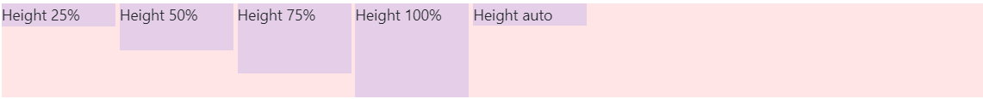
Bootstrap Sizing Utility
<div style="height: 100px; background-color: rgba(255,0,0,0.1);">
<div class="h-25 d-inline-block" style="width: 120px; background-color: rgba(0,0,255,.1)">Height 25%</div>
<div class="h-50 d-inline-block" style="width: 120px; background-color: rgba(0,0,255,.1)">Height 50%</div>
<div class="h-75 d-inline-block" style="width: 120px; background-color: rgba(0,0,255,.1)">Height 75%</div>
<div class="h-100 d-inline-block" style="width: 120px; background-color: rgba(0,0,255,.1)">Height 100%</div>
<div class="h-auto d-inline-block" style="width: 120px; background-color: rgba(0,0,255,.1)">Height auto</div>
</div>

Slide 21
Bootstrap Navbar
Navbars require a wrapping .navbar with .navbar-expand{-sm|-md|-lg|-xl} for responsive collapsing and color scheme classes
Navbars and their contents are fluid by default
Navbars are also responsive by default
Navbars are hidden by default when printing
Source
https://getbootstrap.com/docs/4.0/components/navbar/

Slide 22
Bootstrap Navbar
<nav class="navbar navbar-expand-lg navbar-light bg-light">
<a class="navbar-brand" href="#">Navbar</a>
<button class="navbar-toggler" type="button" data-toggle="collapse" data-target="#navbarNavAltMarkup" aria-controls="navbarNavAltMarkup" aria-expanded="false" aria-label="Toggle navigation">
<span class="navbar-toggler-icon"></span>
</button>
<div class="collapse navbar-collapse" id="navbarNavAltMarkup">
<div class="navbar-nav">
<a class="nav-item nav-link active" href="#">Home <span class="sr-only">(current)</span></a>
<a class="nav-item nav-link" href="#">Features</a>
<a class="nav-item nav-link" href="#">Pricing</a>
<a class="nav-item nav-link disabled" href="#">Disabled</a>
</div> </div></nav>

Slide 23
Bootstrap Cards
A Bootstrap card is a flexible and extensible content container. It includes options for headers and footers, etc., contextual background colors, and powerful display options. Cards replace the Bootstrap 3 panels, wells, and thumbnails
Source
https://getbootstrap.com/docs/4.0/components/card/

Slide 24
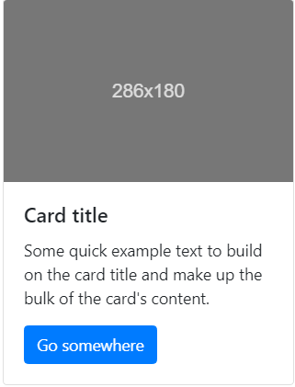
Bootstrap Cards
<nav class="navbar navbar-expand-lg navbar-light bg-light">
href="#">Features</a>
<a class="nav-item nav-link" href="#">Pricing</a>
<a class="nav-item nav-link disabled" href="#">Disabled</a>
</div>
</div>
</nav>

Slide 25
Bootstrap Forms
Bootstrap form controls expand on form styles with classes; which can be used to customize displays for a more consistent rendering across browsers and devices
Forms include validation type attributes on all inputs (e.g., email for email address or number for numerical information)
Source
https://getbootstrap.com/docs/4.0/components/forms/

Slide 26

Bootstrap orms
<form class="form-inline">
<div class="form-group mb-2">
<label for="staticEmail2" class="sr-only">Email</label>
<input type="text" readonly class="form-control-plaintext" id="staticEmail2" value="email@example.com">
</div>
<div class="form-group mx-sm-3 mb-2">
<label for="inputPassword2" class="sr-only">Password</label>
<input type="password" class="form-control" id="inputPassword2" placeholder="Password">
</div>
<button type="submit" class="btn btn-primary mb-2">Confirm identity</button>
</form>

Slide 27
Bootstrap Buttons
Bootstrap includes several predefined button styles, each serving its own semantic purpose
The .btn classes are designed to be used with the <button> element. However, you can also use these classes on <a> or <input> elements (though some browsers may apply a slightly different rendering)
Source
https://getbootstrap.com/docs/4.0/components/buttons/

Slide 28

Bootstrap Buttons
<button type="button" class="btn btn-primary">Primary</button>
<button type="button" class="btn btn-secondary">Secondary</button>
<button type="button" class="btn btn-success">Success</button>
<button type="button" class="btn btn-danger">Danger</button>
<button type="button" class="btn btn-warning">Warning</button>
<button type="button" class="btn btn-info">Info</button>
<button type="button" class="btn btn-light">Light</button>
<button type="button" class="btn btn-dark">Dark</button>
<button type="button" class="btn btn-link">Link</button>

Slide 29
Bootstrap Modals
Modals are built with HTML, CSS, and JavaScript and are positioned over everything else in the document. Clicking on the modal "backdrop" will automatically close the modal
Bootstrap only supports one modal window at a time. Modals use position: fixed, which can sometimes be a bit particular about its rendering
Source
https://getbootstrap.com/docs/4.0/components/modals/

Slide 30
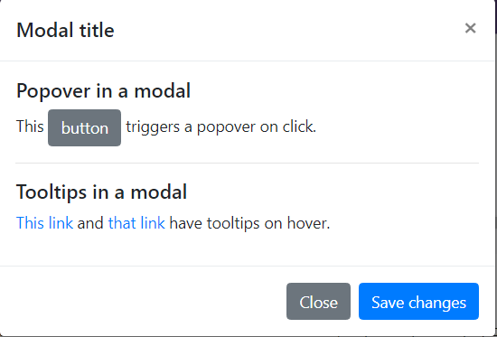
Bootstrap Modals
div class="modal-body">
<h5>Popover in a modal</h5>
<p>This <a href="#" role="button"
class="btn btn-secondary popover-test"
title="Popover title" data-content="Popover body...">
button</a> triggers a popover on click.</p>
<hr>
<h5>Tooltips in a modal</h5>
<p><<a href="#" class="tooltip-test" title="Tooltip">
This link</a> and <a href="#" class="tooltip-test"
title="Tooltip">that link</a> have tooltips on hover.</p>
</div>

Slide 31
What We Covered
Bootstrap CDN Install
Mobile Responsive Definition
The Bootstrap grid system
Accessibility with Bootstrap
Bootstrap theming

Slide 32
What We Covered
Bootstrap utilities
Bootstrap navbar
Bootstrap cards
Bootstrap forms & validation
Bootstrap buttons
Bootstrap modals

Slide 33
Some Useful URLs
https://getbootstrap.com/
https://www.tutorialspoint.com/bootstrap4/index.htm
https://www.w3schools.com/bootstrap4/

